Slide 1
Witness Project Advocates Mentoring Advocates
Workshop 2: Avoiding Risk from Personal Care
Products
Sarah Evans, PhD

Slide 2
Objectives
After Workshop 2, Breast Cancer Risk and Personal Care Products, participants will be able to:
Understand why it’s difficult to be sure of what’s in our personal care products
Define how chemicals in personal care products get into our bodies
Define what it means when a label says “organic” or “natural”
Avoid ingredients in personal care products that are associated with increased breast cancer risk
Choose safer personal care products
Take steps to ensure the safety of products we use every day on ourselves and our children

Slide 3
It’s on the shelf - is it safe?
Federal health statutes do not require companies to test products or ingredients for safety before they are sold.
FDA does not verify that product contents are as listed.
Trade secrets, byproducts, and contaminants are not on the label
Absence of testing does not mean a product is SAFE

Slide 4
Chemical Safety in the U.S.
80,000+ new chemicals since WWII
<20% have been tested for toxicity to children
Toxic Substances Control Act 1976
Exempted 62,000 chemicals
Chemicals banned or restricted in cosmetics
E.U.: 1,100
U.S.: 11

Slide 5
What does the “organic” or “natural” label mean?
Beware of meaningless “greenwashing”.
“Natural”
“Organic”
“Eco”
Look for:
USDA Organic label
Certified 95-100% organic
No synthetic ingredients
NSF/ANSI 305 Label
National Sanitation Foundation certification
Verifies at least 70% organic

Slide 6
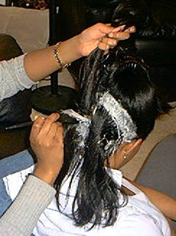
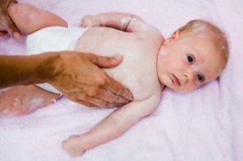
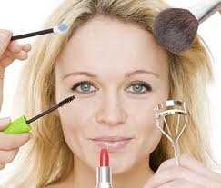
Do chemicals from PCPs get into our bodies?
Number of products used correlates with urinary levels of some chemicals (Romero-Franco 2011, Sathyanarayana 2008)
Mennonite women who use little or no PCPs have much lower urinary levels of certain chemicals (Martina 2012)

Slide 7
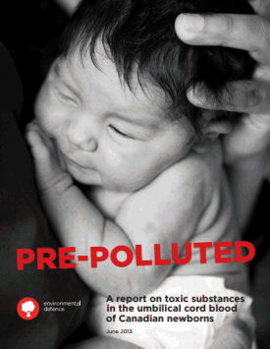
Our Chemical Body Burden
200+ chemicals detected in:
Urine
Blood
Cord Blood
Breast milk
Highest exposures in children
Product use is associated with body burden
Effects of chronic, low-dose, and cumulative exposures are unknown
Notes:
Product use is associated with exposure (phthalates, musks & other)
WOS: in utero development, neonatal development, puberty, pregnancy.

Slide 8
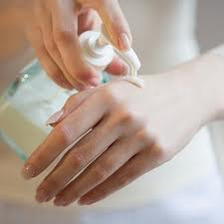
How do chemicals from PCPs get into our bodies?

Slide 9
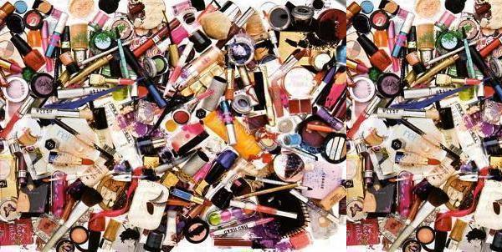
Cumulative exposures
Adult women: 12 products
Teen girls: 17 products

Slide 10
Windows of Susceptibility Not just what, but when
Breast
Cancer
Prenatal Neonatal Puberty Pregnancy Menopause

Slide 11
Children are Uniquely Vulnerable
Close to the ground
Hand-to-mouth behavior
Greater exposure pound-for-pound
Lack of variety in diet
Immature metabolism
More years of future life
Continuously developing
systems:
Reproductive system
Nervous system
Notes:
Breast is continuously developing

Slide 12
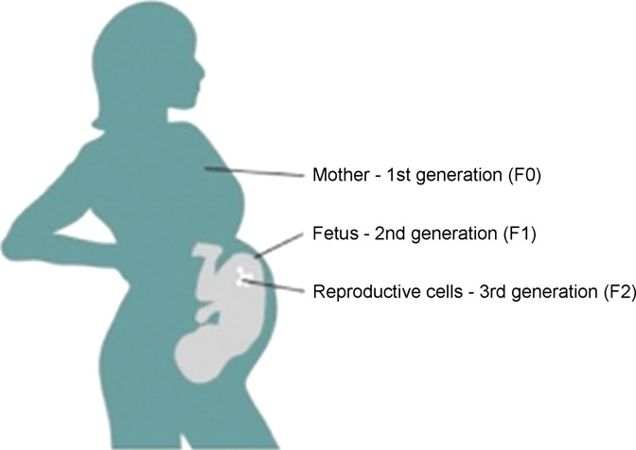
Vulnerability in pregnancy
Transgenerational effects
Perera & Herbstman 2011
Notes:
Dutch Famine
DES
Emerging: phthalates,
fungicides

Slide 13
Key Ingredients to Avoid
Two categories:
Known or suspected carcinogens
Endocrine Disrupting Chemicals

Slide 14
Endocrine Disrupting Chemicals
Substances in our environment, food, and consumer products that interfere with hormone biosynthesis, metabolism, or action resulting in a deviation from normal homeostatic control or reproduction.
-Scientific Statement of the Endocrine Society, 2009

Slide 15
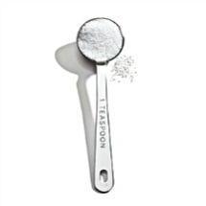
EDCs are active at low doses
Hormones are active at parts per billion (ppb)

Slide 16
Exposure to EDCs
Lifelong
Low-dose
Cumulative
Mixtures

Slide 17
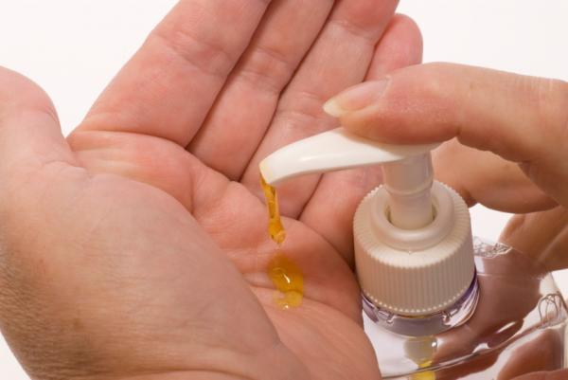
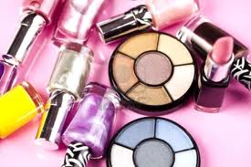
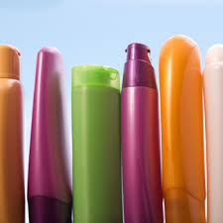
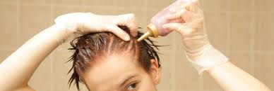
PCPs: What are we talking about?

Slide 18
Suspected breast cancer risk factors in PCPs
Fragrance/Parfum
Phthalates
Triclosan
Formaldehyde
Parabens
1,4-dioxane

Slide 19
Precautionary Principle
Avoid exposure when:
Risk of harm is suspected
Existing scientific evidence cannot prove cause and effect
“Better Safe Than Sorry”

Slide 20
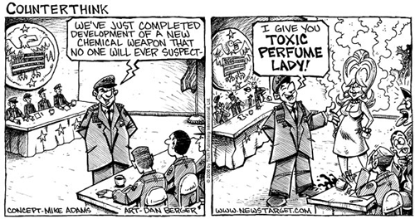
Fragrance

Slide 21
A Word About Fragrance
Mixture of chemicals
Trade secret, not on the label
Usually contains phthalates and other EDCs
EWG Not So Sexy Report:
12 EDCs in fragrance
11 EDCS were estrogenic

Slide 22
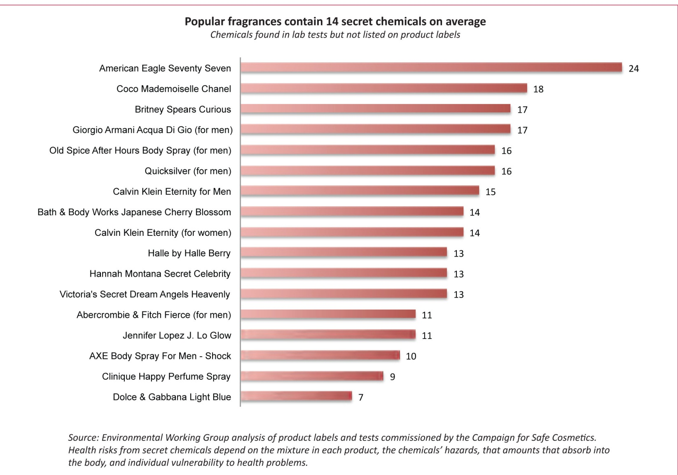
“Secret” ingredients are not on the label
Not So Sexy Report
Environmental Working Group, May 2010
Notes:
12 different EDCs were found, average of 4 per product
Others my be EDCs but not tested

Slide 23
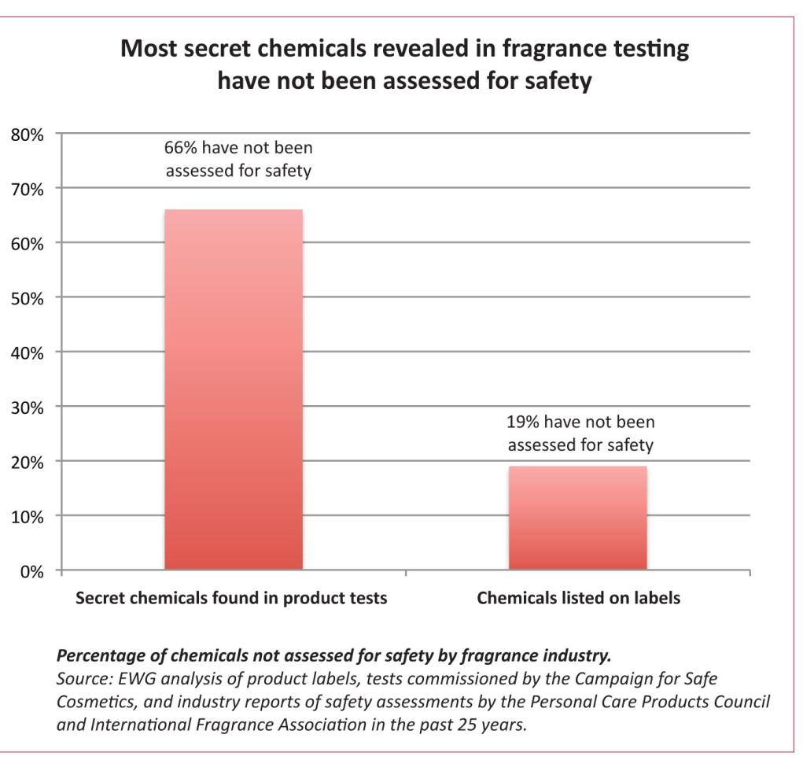
Insufficient Safety Testing
Not So Sexy Report
Environmental Working Group, May 2010
Notes:
Each product on average contained 12 chemicals not tested for safety; 11/12 mimic estrogen or have estrogenic activity in laboratory studies

Slide 24
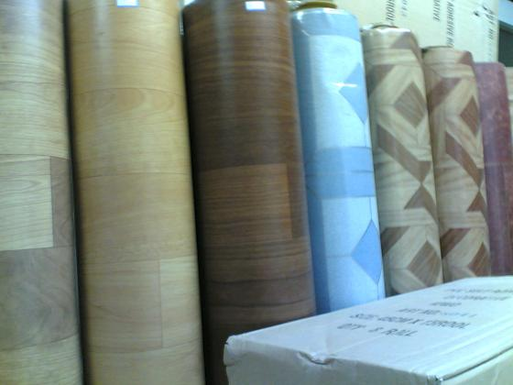
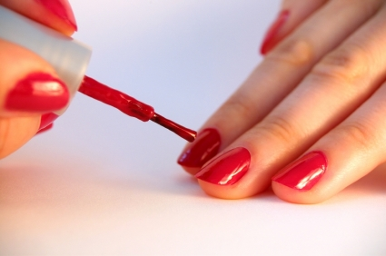
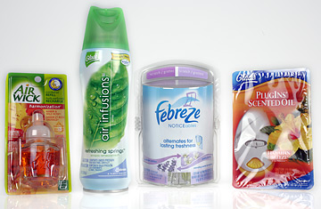
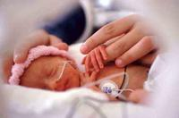
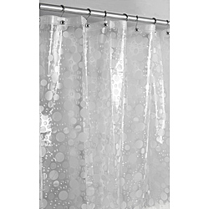
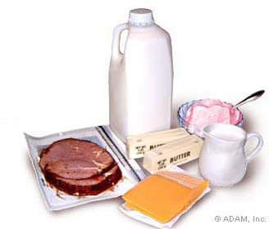
Phthalates

Slide 25
Phthalates in infant care products and cosmetics
Phthalate levels in infant urine associated with:
Lotion
Powder
Shampoo
More products used = higher exposure
Sathyanarayana et al
Pediatrics 2008
Phthalate levels in adult urine:
Associated with number of products used
Very low in Mennonite women
Martina et al
Neurotoxicology 2012
Notes:
Teitelbaum?
DEP associated with BCa in Mexico cohort (lopez-carillo 2010)

Slide 26
Phthalates and Breast Cancer
Cell-based studies
Phthalates are estrogenic
Animal studies:
Altered mammary development
Human studies:
Early puberty in East Harlem cohort
Increased breast cancer risk in a Mexican cohort

Slide 27
Simple Steps to Avoid Phthalates
Choose fragrance-free products
Avoid “masking fragrance”
Choose “three-free” nail polish (no phthalates, toluene, or formaldehyde)
Wet mop and dust
Avoid microwaving in plastic
Avoid products made from vinyl
Avoid # 3 plastic
Notes:
Phthalates are not on the label

Slide 28
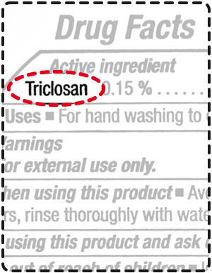
Triclosan
Antibacterial
Estrogenic in cell and animal
studies
Found in:
Antibacterial soaps
Some toothpaste
Fabrics and other products
labeled antibacterial

Slide 29
Simple Steps to Avoid Triclosan
Choose to wash your hands with regular soap and water
Choose fragrance-free alcohol based sanitizer when you’re on the go
Choose different cutting boards for meat and produce; wash with hot soap and water
Avoid products containing antimicrobials (clothing, cutting boards, toothbrushes etc.)

Slide 30
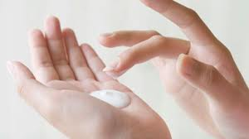
Parabens
Antimicrobial: prolong shelf life
Found in breast tumor biopsies
Estrogenic in cell-based experiments
Association with breast cancer is controversial
Found in: lotions, cosmetics, foods, drugs
May be labeled as:
Ethylparaben
Methylparaben
Butylparaben
Propylparaben

Slide 31
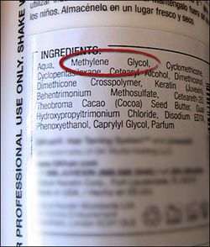
Formaldehyde
Known carcinogen (IARC, EPA)
Byproduct: Not on the label
also known as methanal, methylene oxide, oxymethyline, methylaldehyde, oxomethane, methylene glycol or formalin
Gas; can be inhaled, increased release with heat
In hair smoothing products, shampoo, body wash, nail polish and more
AVOID:
DMDM hydantoin
Diazolidinyl Urea
Imidazolidinyl Urea)
Quaternium-15
Sodium hydroxymethylglycinate,
2-bromo-2-nitropropane-1,3-diol (bromopol)

Slide 32
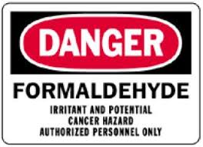
A Word About Hair Straighteners
Contain carcinogens and EDCs
May contain more than 10% pure formaldehyde
Some products have formaldehyde levels 50 times the safe limit
Don’t believe manufacturer’s “formaldehyde free” claims
Look for independent testing (EWG, Health Canada)

Slide 33
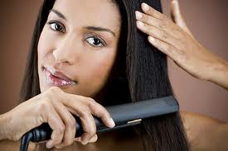
Hair Straightener Alternatives
100% argan oil to manage frizz
Hot combs, flat irons, blow dryers
Wide diameter barrel curling iron held backwards
Natural curls

Slide 34
1,4 dioxane
Known carcinogen (IARC)
Not on the label
Banned in cosmetics in Canada
Penetrates the skin
Byproduct of:
Polyethlene glycol (PEG)
Sodium laureth sulfate (SLS)
ceteareth compounds
“oleth” compounds
“xynol” compounds

Slide 35
Summary of ingredients to avoid
Synthetic fragrance, masking fragrance,parfum
Phthalates
Triclosan
Parabens
Formaldehyde (avoid DMDM Hydantoin, Diazolidinyl Urea and Imidazolidinyl Urea)
1,4-dioxane (avoid sodium laureth sulfate, ceteareth, polyethylene glycol/PEG)

Slide 36
The Precautionary Principle
Science was right and you avoid exposure
SAFE
Science was wrong and you avoid exposure
SAFE
Science was right and you don’t avoid exposure
NOT SAFE

Slide 37
Simple steps to improve the safety of your products
Use fewer products.
Read labels and beware of ““greenwashing”
Avoid aerosolized sprays and loose powders.
Wash hands with plain soap and water
Ventilate

Slide 38
Simple Steps, Broad Impact
Support companies that are reducing the use of toxic chemicals in personal care products.
Support companies that disclose all ingredients
Support research on the effects of common chemicals – science is needed to inform policy.
Support the Safe Chemicals Act.
Utilize your social networks to educate others!

